Slide 1
Topic: Place Value
EQ: What is place value with decimals?
Get your VIVO’s

Slide 2
Topic: Place Value
EQ: What is place value with decimals?
A line with numbers marked at intervals in relation to each other
Number Line
1
10
Explain your thinking
How do you know that your numbers are in the right place?
Notes:
Have them draw a number line with 1 and 10 on the ends
Have them just place 2 and 3 on the number line then afterwards add in the other numbers. Ask them does it look right? Does anything look wrong?
Have them repeat it starting with 2 and 3 again. What did they change?
Try again – starting with 8 then 2

Slide 3
Topic: Place Value
EQ: What is place value with decimals?
Number Line
1
100
Notes:
Have them draw a number line with 1 and 100 on the ends
Have them just place 10 and 20 on the number line then afterwards add in the other numbers. Ask them does it look right? Does anything look wrong?
Have them repeat it starting with 10 and 20 again. What did they change?
Try again – starting with 80 then 50

Slide 4
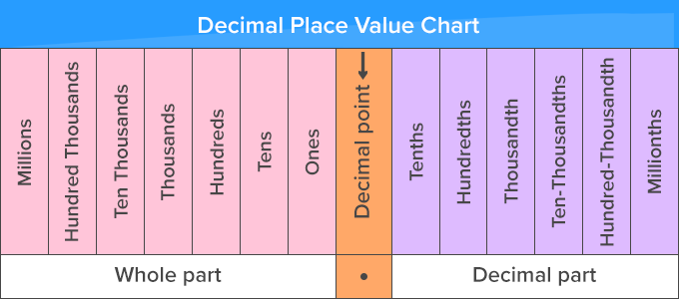
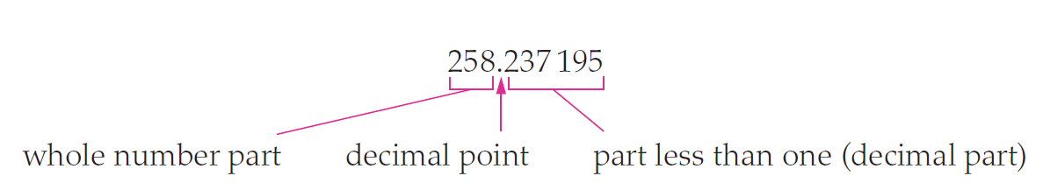
Topic: Place Value
EQ: What is place value with decimals?
Definition of Place Value
The value of the number based on its location
Decimals and place value?

Slide 5
Left-Hand-Side- Roll dice to make numbers
Roll the dice 3 times
Make the smallest number you can
Roll the dice 4 times
Make the largest number you can
Roll the dice 6 times
Make the smallest and largest number you can

Slide 6
Glossary Building Activity
Addition
Ascending
Estimate
Integer
Negative
Number line
Place value
Product
Whole numbers

